Slide 1

Exploratory Data Analysis
<G2M Case Study>
Wenjie Zheng
<2023/07/23>

Slide 2
Background-G2M Case Study
Background: XYZ is a private equity firm in US. Due to remarkable growth in the Cab Industry in last few years and multiple key players in the market, it is planning for an investment in Cab industry.
Objective: Provide actionable insights to help XYZ firm in identifying the right company for making investment.
Companies: Yellow Cab and Pink Cab
Data Sets: Cab_Data.csv, Customer_Data.csv, Transaction_Data.csv, City.csv

Slide 3
Data Understanding
Data Cleaning: merging all the four files into one file based on their shared attributes.
Timeframe of the merged data: 2016-01-31 to 2018-12-31.
Total observations: 359392
Characteristics of the data: longitudinal data (repeated measures of the same observation/unit over time.

Slide 4
Business Problem
Investment decision: which company should be invested?
Pink Cab or Yellow Cab?

Slide 5
Data Analysis
Analysis of Profit
Analysis of Gender
Analysis of Payment Mode
Analysis of Age
Analysis of Users in Cities

Slide 6
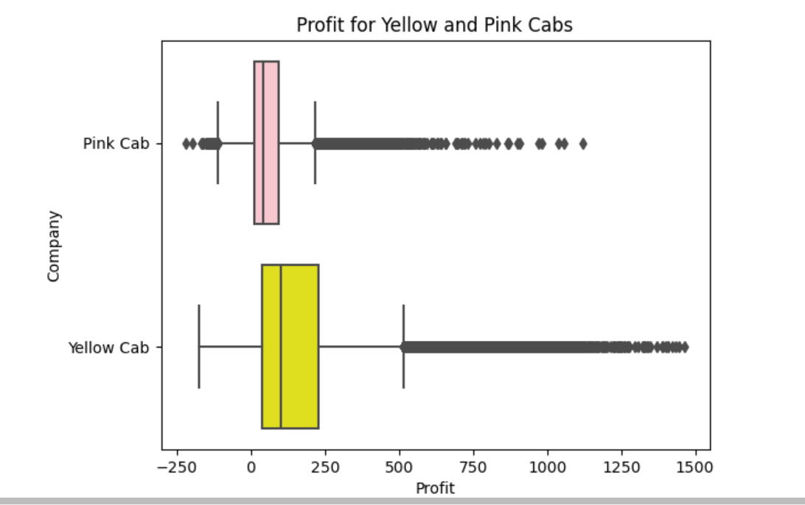
Analysis of Profit
The mean profit for Yellow
Cab per ride is much larger
than Pink Cab.
The mean profit per ride
of Yellow Cab is 160.259986.
The mean profit per ride
of Pink Cab is 62.652174.
The difference shows that
Yellow Cab is more profitable
than Pink Cab

Slide 7
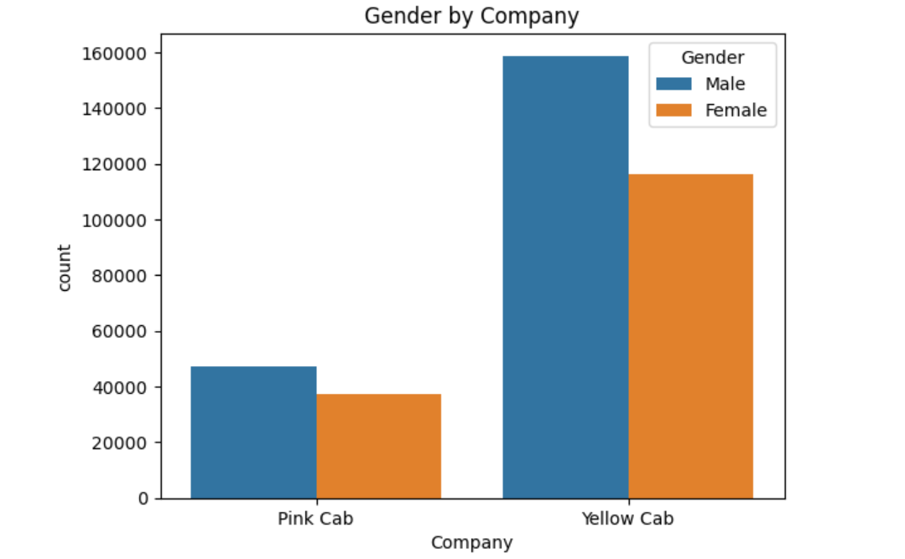
Analysis of Gender
The bar graph shows the gender
composition of two companies.
Both companies exhibit a similar
pattern in gender composition.
Males have more counts than
females, on average.
A commonality is that males are
more likely to have more demands
than females in cab service.

Slide 8
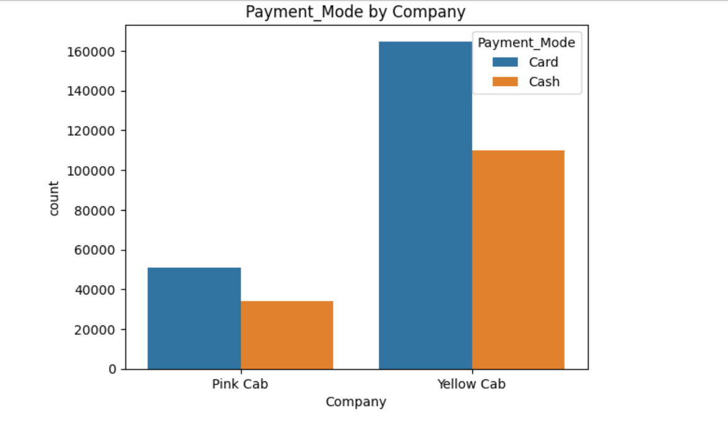
Analysis of Payment Mode
The bar graph shows the payment
mode of two companies.
Both companies exhibit a similar
pattern that card has more counts
than cash, on average.
An implication is that card is
more likely to be a more popular
payment mode than cash.

Slide 9
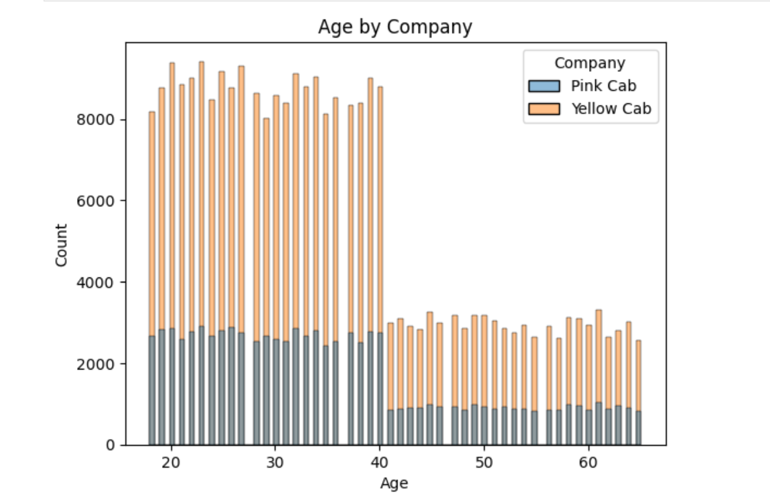
Analysis of Age
The histogram shows the age
distribtion of two companies.
Both companies exhibit a similar
pattern that the age range around
20-40 has more counts than that
40-60.
A possible implication is that most
users or customers with an age range
around 20 to 40. In other words, the
age of customers matters for both companies

Slide 10
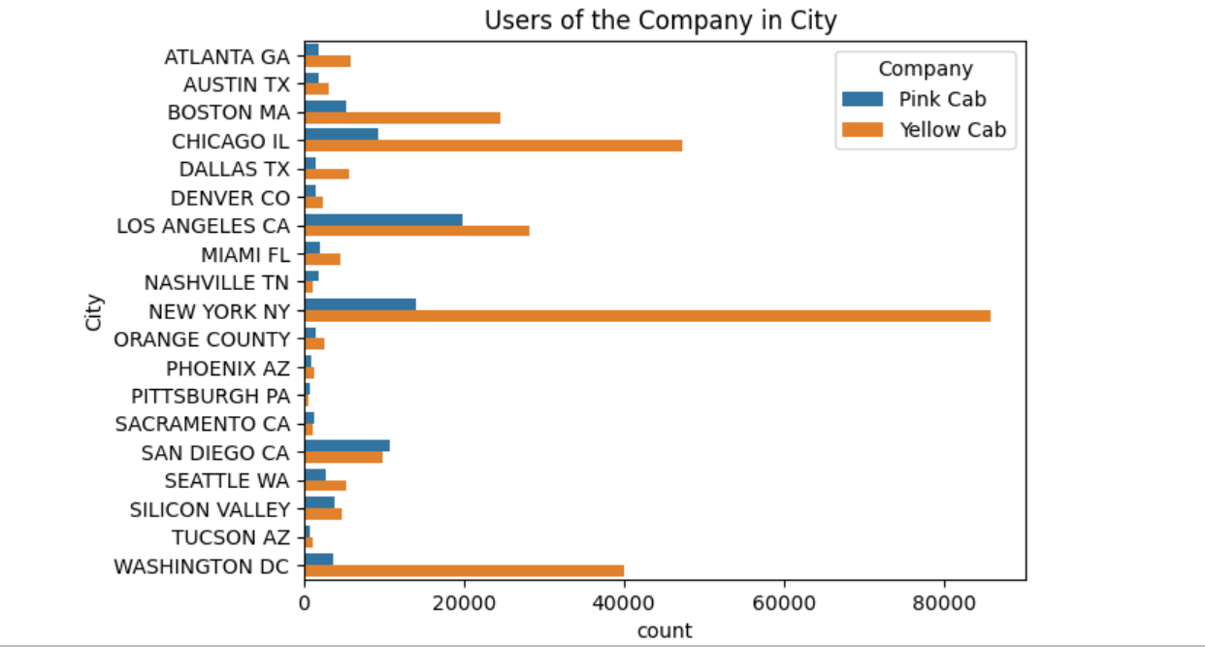
Analysis of Users in Cities
The vertical bar graph shows the
user distribtion of two companies in
US Cities.
The most users of Pink Cab: LA
The most users of Pink Cab: NY
The geographic location plays an
important role in determining the
number users of two Cab
Companies.

Slide 11
Recommendations
It is striking that Yellow Cab has a better performance in terms of its number of users and profitability than Pink Cab.
The gender composition is a crucial factor for both companies. Generally speaking, males have more demands in cab service than females, on average.
The card is a more popular payment mode than the cash.
The age of users in two cab companies shows that most users come from an age range around 20-40. Both companies should attract more potential young users.
The geographic location can explain the users’ distribution in both companies.

Slide 12
Conclusion
We highly recommend Yellow Cab for investment based on analyses above.
However, it is also important some limitations as well.
First, the data sets are observational. This implies that casuality is hardly possible.
Keep in mind that correlation does not imply causation.
Second, we should consider cofounder variables in the analysis. The estimates may be biased.
Lastly, the prediction of future values may not be accurate from the past observations.

Slide 13
Thank You!

